Slide 1
El Relicario
España
Costa Rica

Slide 2
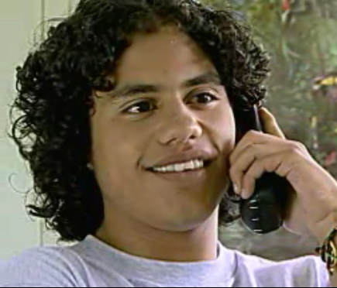

Slide 3
young Jorge Calderón

Slide 4
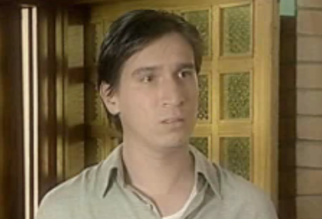

Slide 5
Jorge Calderón (when he was young)

Slide 6
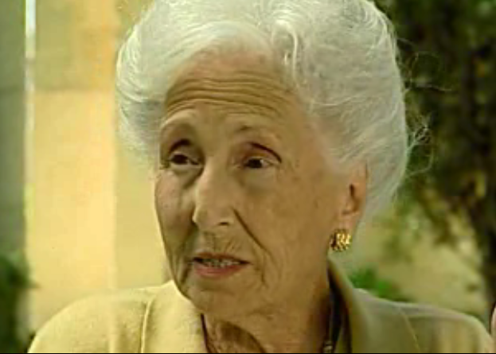

Slide 7
Consuelo

Slide 8
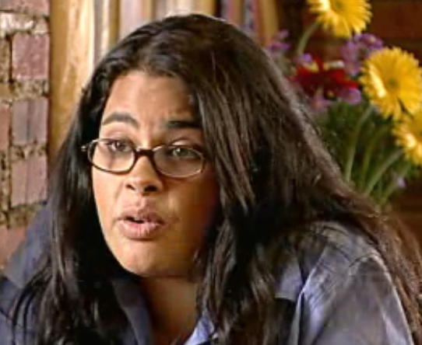

Slide 9
Diana Álvarez

Slide 10
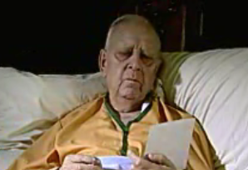

Slide 11
Alberto Gallegos (as an old man)

Slide 12
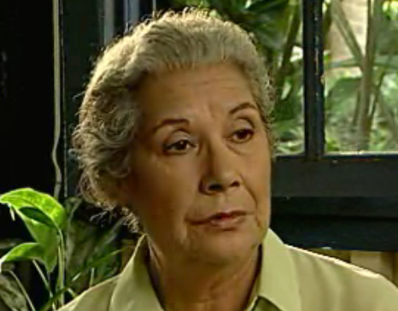

Slide 13
Sonia

Slide 15
Tía Candela

Slide 16
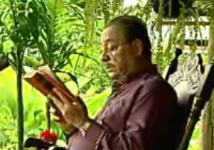

Slide 17
old man on porch

Slide 18
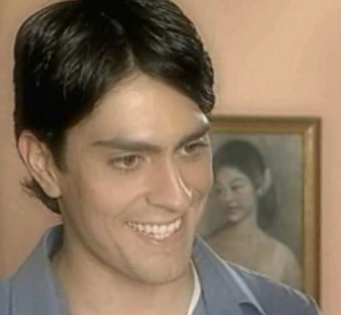

Slide 19
Alberto Gallegos (when he was young)

Slide 20
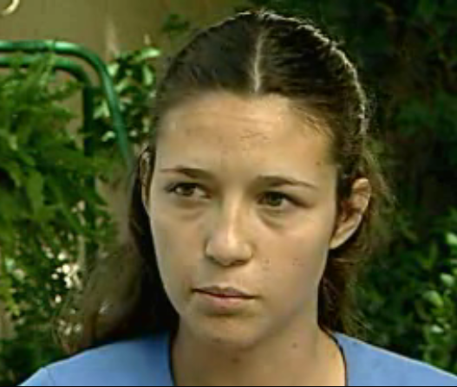

Slide 21
Victoria

Slide 22
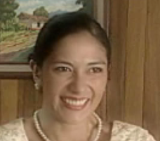

Slide 23
Graciela (when she was young)

